Slide 1

Processing Systems
Mr Butler | AS Digital Technology

Slide 2










You should be able to:
  describe batch processing and real-time processing;
  evaluate the use of batch processing and real-time processing for common applications;
  describe the input, output and processing involved in a range of common devices:
    automatic teller machines (ATMs),
    point of sale (POS) terminals,
    smartphones;
“You don’t have to be great to start, but you have to start to be great”

Slide 3

What actually is processing?
Glossary: Processing is the action or activity that is carried out as part of a computer system. The results from a process will then be passed to other processes, or to an output.
It is the act of doing something with data to produce an output, and is at the centre of an information system.
Processing is carried out by a processing unit, such as a CPU or GPU.

Slide 4

There are two types of processing we need to look at:
Batch Processing
Real Time Processing
All the data is collected together before being processed as a single efficient operation.
This method is also used when computer users submit individual jobs that are processed together as a batch. A job in this instance refers to a package of work regarded by the computer as a single unit
Transactions are grouped until a sufficient quantity is available or until a particular time is reached, as transactions are collected over a period of time
All transactions in a batch undergo the same processing, usually taking place during an off peak period (such as at night) with no human intervention being required
The output is generated together
This form of processing can react fast enough to influence behaviour in the outside world. This is because some tasks need to meet real time deadlines regardless of the required computer work.
The output information is required immediately, such as a missile guidance system or air traffic control.
These systems are fast, but do not process data instantly, as all processing takes some time. They do, however, process data very quickly/immediately.
There needs to be redundancy in this type of system – extra hardware that isn’t used regularly but in case there is a surge in demand/increased data to process. This redundant data can also be used if there is some hardware failure.

Slide 5
Benefits and Drawbacks of Batch Processing
Advantages
Disadvantages
Useful for high volumes of applications which require the same processing to be done on every transaction (where immediate response is not essential).
Can be done at off peak times as human intervention is not essential. e.g. overnight.
  By doing this a company can get more work out of the computer hardware it owns.
a batch processing system can often be cheaper than that required to implement a real-time system to do the same job.
As input or transactions me to be processed later the stored data becomes out of date between processing runs.
  The master file is therefore not always kept up to date.
  This makes batch processing unsuitable for some applications.
There is always a delay before work is processed and output is obtained.

Slide 6
Benefits and Drawbacks of Real-Time Processing
Advantages
Disadvantages
Some tasks would be impossible to do (Such as air traffic control)
No delay in response – output is generated (almost) immediately.
Information is always up to date, meaning users always have accurate information available.
Much easier/quicker to analyse the information as it is available once processed
Real time systems are very expensive to produce and tend to be complicated to create
Require a lot of development time
Back up hardware is required (redundancy)
Difficult to audit, as processing is continually occurring with continuous inputs, processes and outputs happening at once.

Slide 7
Exemplar Question
Q
The examination results are processed using batch processing.
Describe the main features of batch processing.
[4]
STEP 1: Definition
Data to be processed is grouped/held in bundles
… until a suitable quantity/processing time is reached
The entire data is processed in one go.
STEP 2: Key Terms
Data to be processed is grouped/held in bundles
… until a suitable quantity/processing time is reached. This is called a batch
The entire batch is processed in one go,
…usually at an off-peak period such as overnight.
This is processed without human intervention using validation.
Data to be processed is grouped/held in bundles
… until a suitable quantity/processing time is reached. This is called a batch
The entire batch is processed in one go,
…usually at an off-peak period such as overnight.
This is processed without human intervention
… as all data undergoes the same processing.
… Validation is often used, such as control or batch total.
STEP 3: Add Explanation

Slide 8
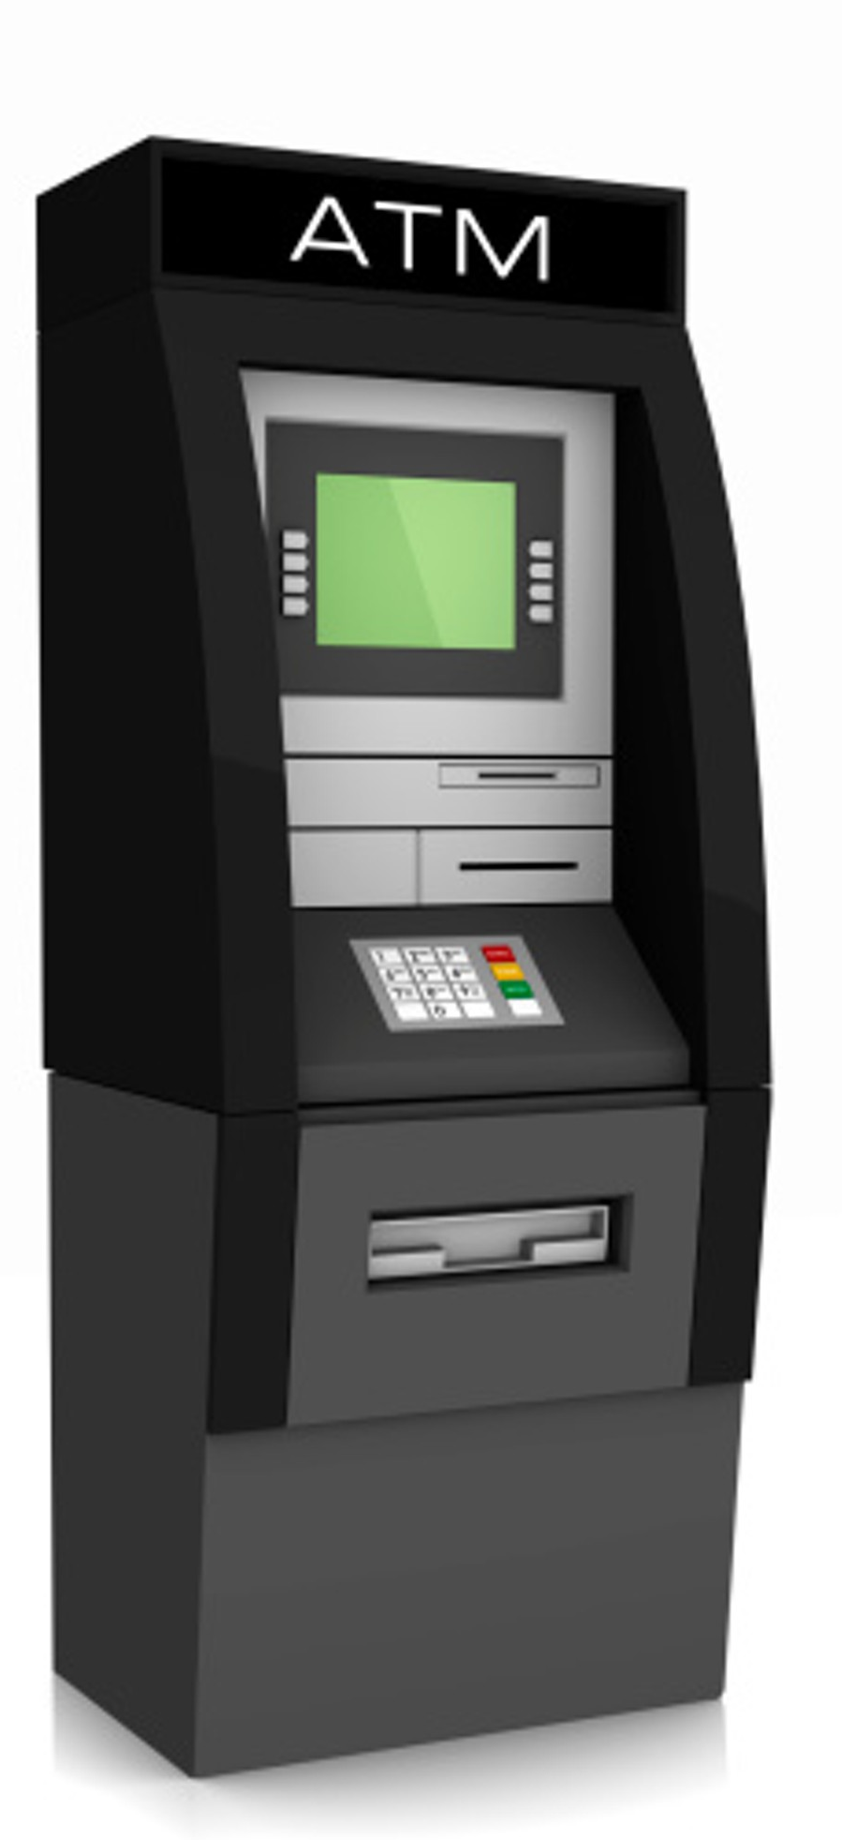
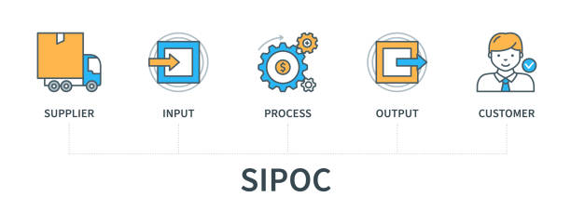
Automated Teller Machines (ATMs)
Also known as cash dispensers, an ATM is a machine that automatically issues banknotes to customers when authorised by a credit/debit card, and authenticated by a PIN. The user’s bank account is updated with the value of the transaction.
What Are They?
INPUTS
PROCESSES
OUTPUTS
Cash Card
PIN (Personal Identification Number)
Menu Choice/Option
Amount of Cash
Checking Balance on account
Changing PIN
Updating Balance on account
Generating Receipt
Cash/Sum of money
User Instructions on the screen
Error Messages on the screen
Printed Receipt
Sounds (i.e. beeps)

Slide 9
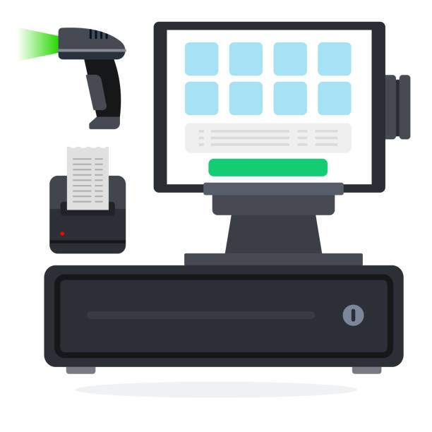
POS (Point Of Sale) Terminals
Specialist terminals used at supermarket checkouts. Having a variety of functions such as electronic funds transfer and barcode scanning to allow prices to be pulled from a database on the network to produce a customers bill.
What Are They?
INPUTS
PROCESSES
OUTPUTS
Cash Card
PIN (Personal Identification Number)
Product Barcode
Amount of Cash
Check cost of item
Create Order
Updating Balance due
Generating Receipt
User Instructions on the screen
Messages on the screen
Printed Receipt
Sounds (i.e. beeps)

Slide 10

Smart Phones
Pocket sized devices that are mobile phones as well as mobile computers with internet connectivity. They are a development of the mobile phone and most solely interact with the user through a touch-screen interface.
What Are They?
INPUTS
PROCESSES
OUTPUTS
Touch screen
Voice/Sound
Camera
Making/Receiving calls
Loading apps
Checking message received
Loading notifications
Images
Messages on the screen
Vibrations (haptic)
Sounds (i.e. beeps)

Slide 11

Questions
Expand the acronym POS [1]
Describe the main features of batch processing [4]
Describe the main features of real-time processing [4]
Explain why batch processing is suitable for a payroll application but unsuitable for a stock control application [4]
Describe how batch processing is used to produce monthly bank statements [3]
Justify the use of real-time processing for customer transactions at Automated Teller Machines [4]

Slide 12
Mark Scheme: Expand the acronym POS [1]
Ans: Point of Sale
This question would not be something CCEA would ask at A Level. However, it is important you know and expect acronyms to be used in questions. In some cases (especially web applications topic), CCEA mark schemes give marks for expanding these!

Slide 13
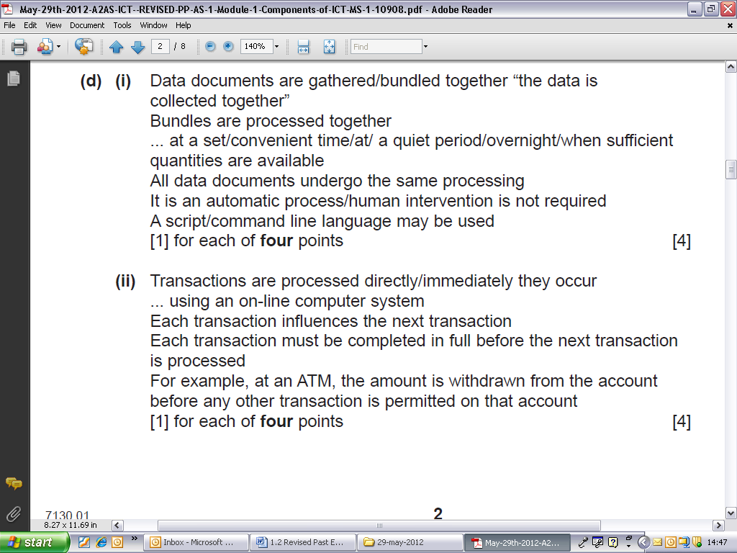
Mark Scheme: Describe the main features of batch processing [4]
Ans:
This is a very easy question for CCEA to ask, and whilst CCEA have asked this question as 4 marks here, it is really important you can answer this to at least 6 marks, especially if they need to make longer/extended questions around a scenario where you need to justify why they would use this etc.

Slide 14
Mark Scheme: Describe the main features of real-time processing [4]
Ans:
Again, CCEA could ask this and further make it a six mark question by adding benefits of using or drawbacks for using. In some cases, you need to give both sides of the argument depending on how the question is worded!

Slide 15
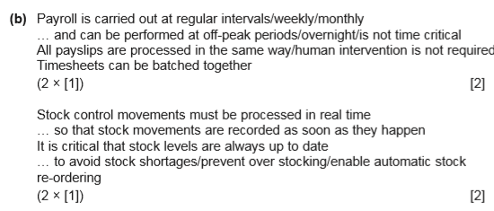
Mark Scheme: Explain why batch processing is suitable for a payroll application but unsuitable for a stock control application [4]
Ans:
This question popped up in a paper, and was badly answered by candidates. This was noted as often the candidate would only answer one part of this and only take one angle – you need to ensure you answer this question in full.

Slide 16
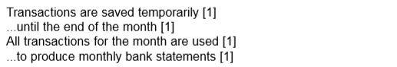
Mark Scheme: Describe how batch processing is used to produce monthly bank statements [3]
Ans:
A question like this is actually pretty difficult – CCEA in fact gave 8 lines to write your answer, but were very specific in how they wanted you to answer. There is virtually no wiggle room in the wording of your answer. I would certainly recommend taking this exact wording down in case it reappears in future!

Slide 17
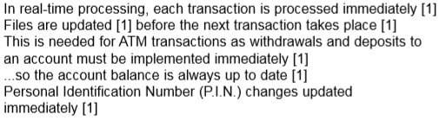
Mark Scheme: Justify the use of real-time processing for customer transactions at Automated Teller Machines [4]
Ans:
Look how, even with the 4 mark questions, CCEA want you to follow the three steps. The mark scheme is broken down into the three steps (Definition, Using Key Terms, Explanation). This goes for longer questions, but it’s clear you get it from the shorter questions too.

